Slide 1

Prediction of crypto art prices with CNN – and the overall influence on
the art economy
Master Thesis
Kseniia Teslenko

Slide 2
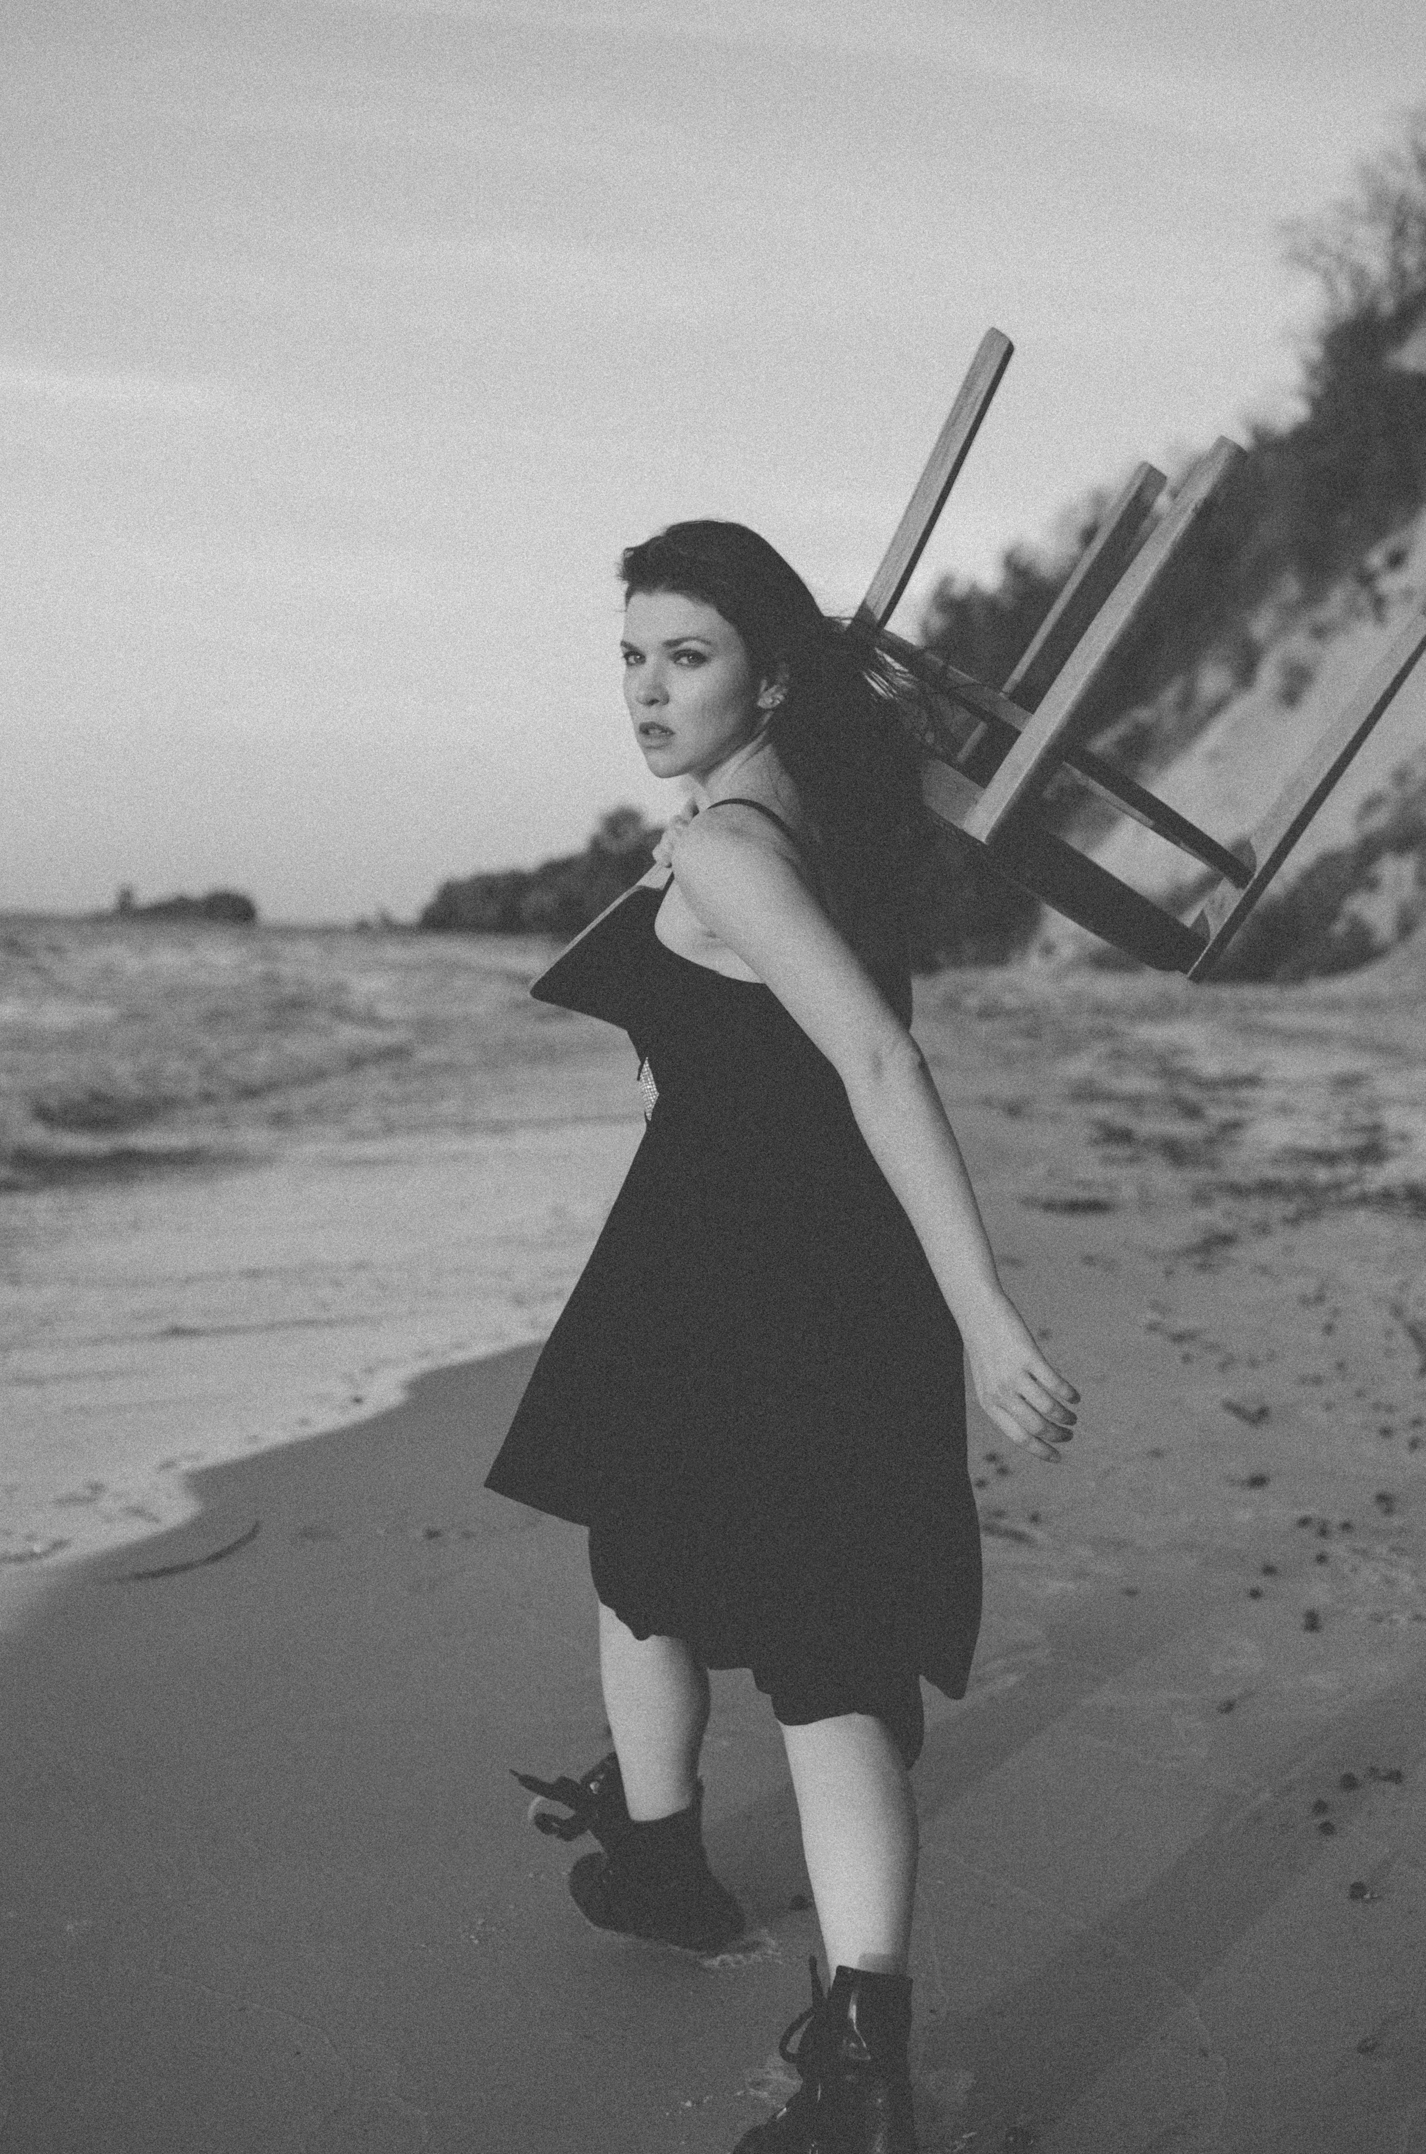
Who am I?
My academic journey
Taras Shevchenko National University of Kyiv
BA of Arts in Philology
Free University of Berlin
BA of Arts in Political Science
Humboldt University of Berlin
MA of Arts in Social Science

Slide 3
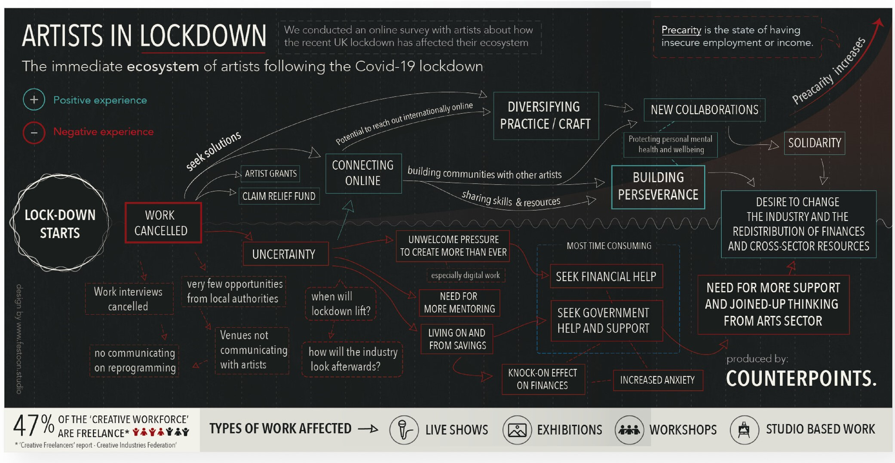
Precarity in the Berlin Club Scene and the Influence of the Corvid-19 Pandemic

Slide 4
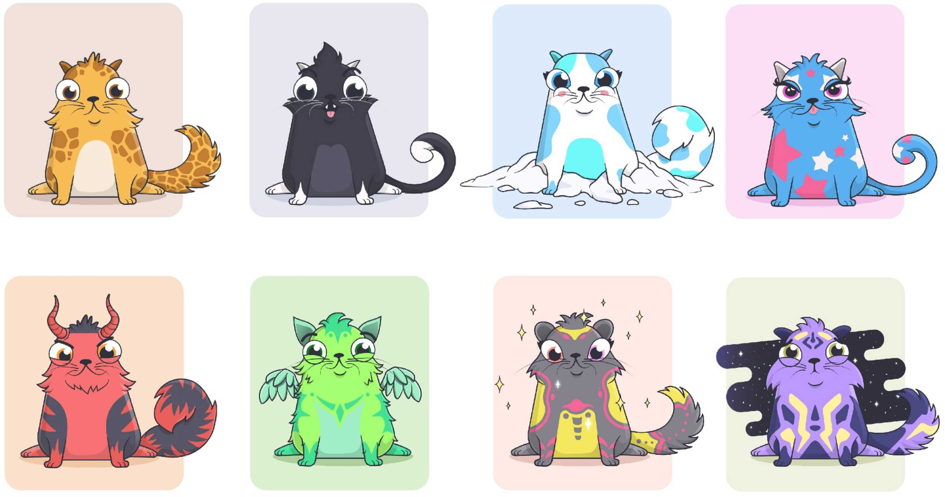
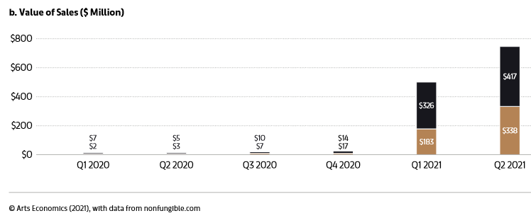
NFT to the rescue!
Before: from September to December 2020
Pre-Boom: January to February 2021
Boom: March to April 2021
Post-Boom: from May to the first week of June 2021
Art Basel: "Digital art was highlighted in 2021 with the growth of sales via non-fungible token (NFT) platforms. It remained a relatively small proportion of high net worth (HNW) collectors’ collections compared to traditional art forms, however, overall, 16% of the works they owned were digital, film, and video art, showing the growing significance of these mediums."

Slide 5
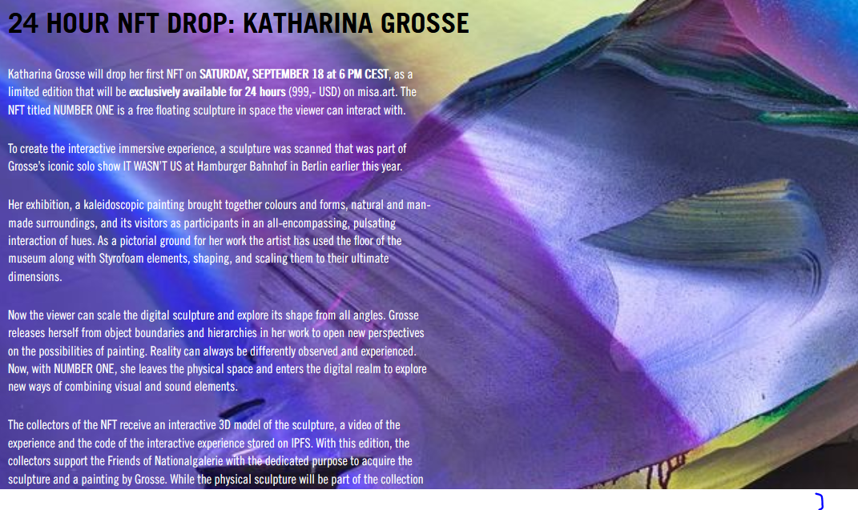
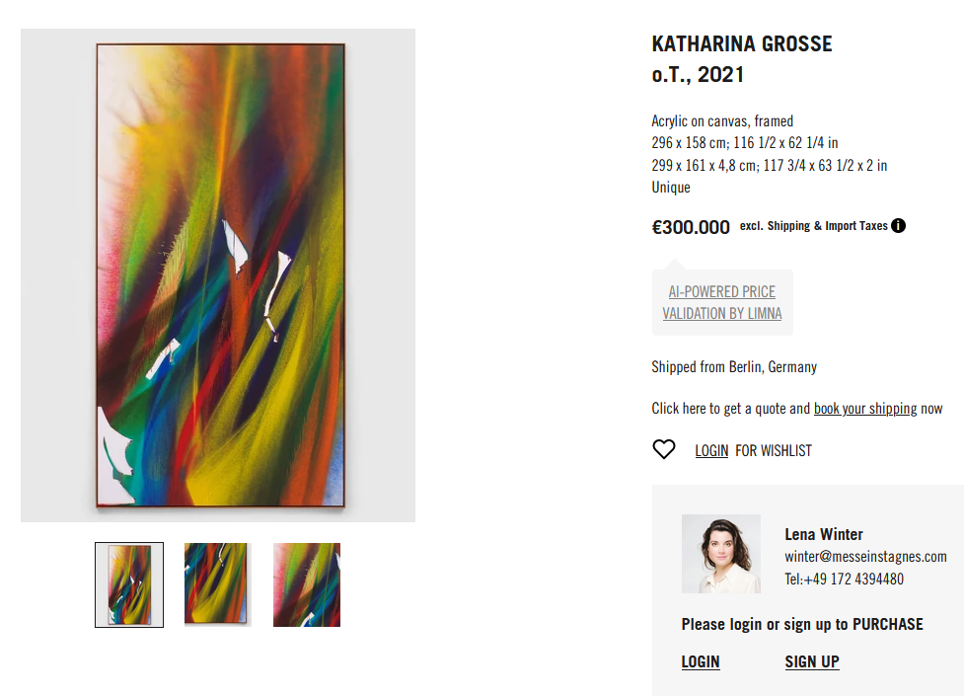
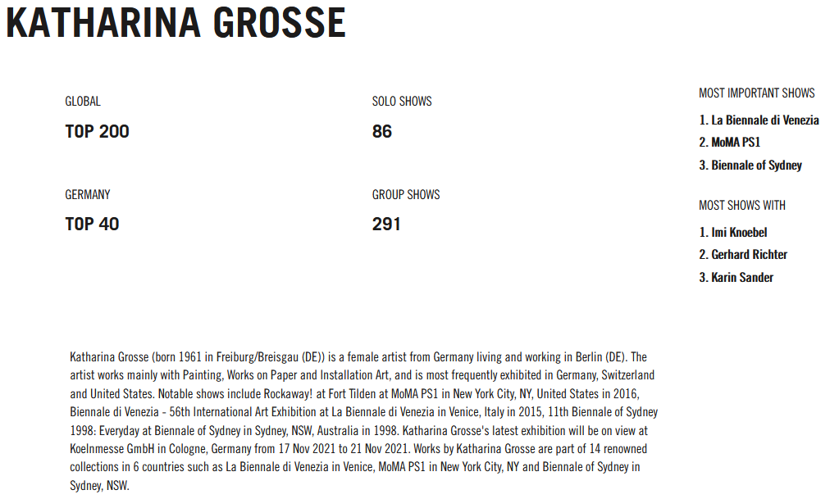
https://cdn.shopify.com/videos/c/vp/70103bf0252f48e58630f4b9cc1441a0/70103bf0252f48e58630f4b9cc1441a0.HD-720p-1.6Mbps.mp4

Slide 6
NFTs' advantages compared to traditional art
Art's market decentralization & independence from art dealers, galleries, etc.
NFT’s scarcity and provenance are secure - records of authenticity and chain-of-ownership.
"Smart contract"ensures that NFT-artists get a cut in resale royalties.
Artistic reputation - dependence from galleries, auction houses, personal contacts.
Copyright problem & theft.
No-transparency inside the market and system of royalties for artists.
Audience as a part of artistic reputation

Slide 7
Dataset development
scrap one of the most popular NFTs marketplace OpeanSea
Art Block Curated collection
links to the artists’ social media which allows me to add the number of followers to my dataset
#2 on the website by overall NFT net worth
the data set will consist:
image
prices (first sold, last sold, last offer)
description
number of followers in twitter
number of followers in instagram

Slide 8
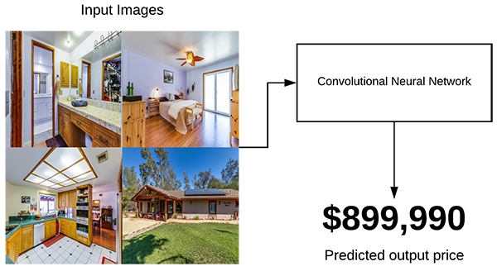
ML Model CNN
recognize trends: patterns, colors, etc.
predict the price
analysis of feature importance and/or visualize the image features that result in higher or lower price predictions
PyTorch

Slide 9
The purpose of the thesis
to go beyond the classical research methods in social science
to analyse if the digital art economy built around NFTs can support artists financially, particularly during such challenging times as COVID-19 with its precarity, uncertain art economy and poor job market
to analyse what factors influence the price development of crypto art

Slide 10
Content ( work-in-progress)
1. Introduction
2. Theoretical Part
2.1. Artistic precarity
2.2. Digitalisation
2.3. Digital art
2.4. Digitalised art
2.5. Art economy
2.6. NFT
2.7. Digital art marketplaces
2.7.1. Digital auctions
2.7.2. NFTs auctions
2.8. The price of art pieces
2.8.1. Reputation (traditional)
2.8.2. The role of internet popularity
2.8.3. Quality factors of painting
3. Methodological Part
3.1. Scraping
3.1.1. OpenSea
3.1.2. ArtBlock
3.1.3. Instagram
3.1.4. Twitter
3.2. CNN
3.2.1. Predicting the price of an image
4. Analysis
5. Conclusion
5.1. NFTs as an income for smaller artists?
5.2. Conclusion about CNN

Slide 11
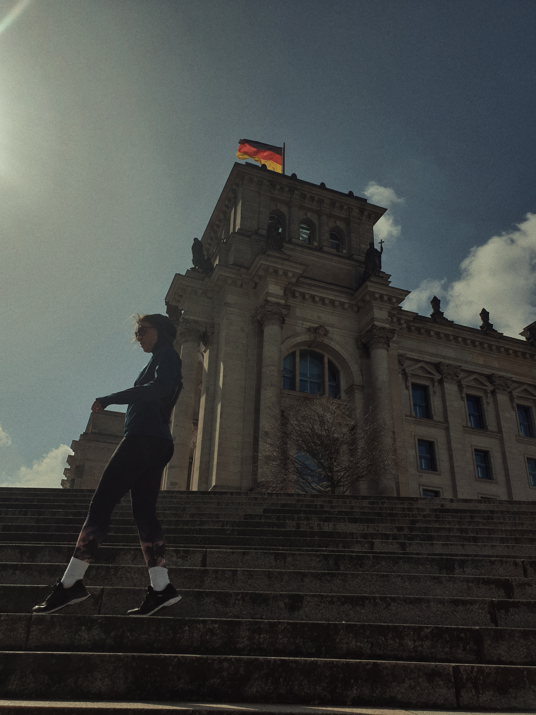
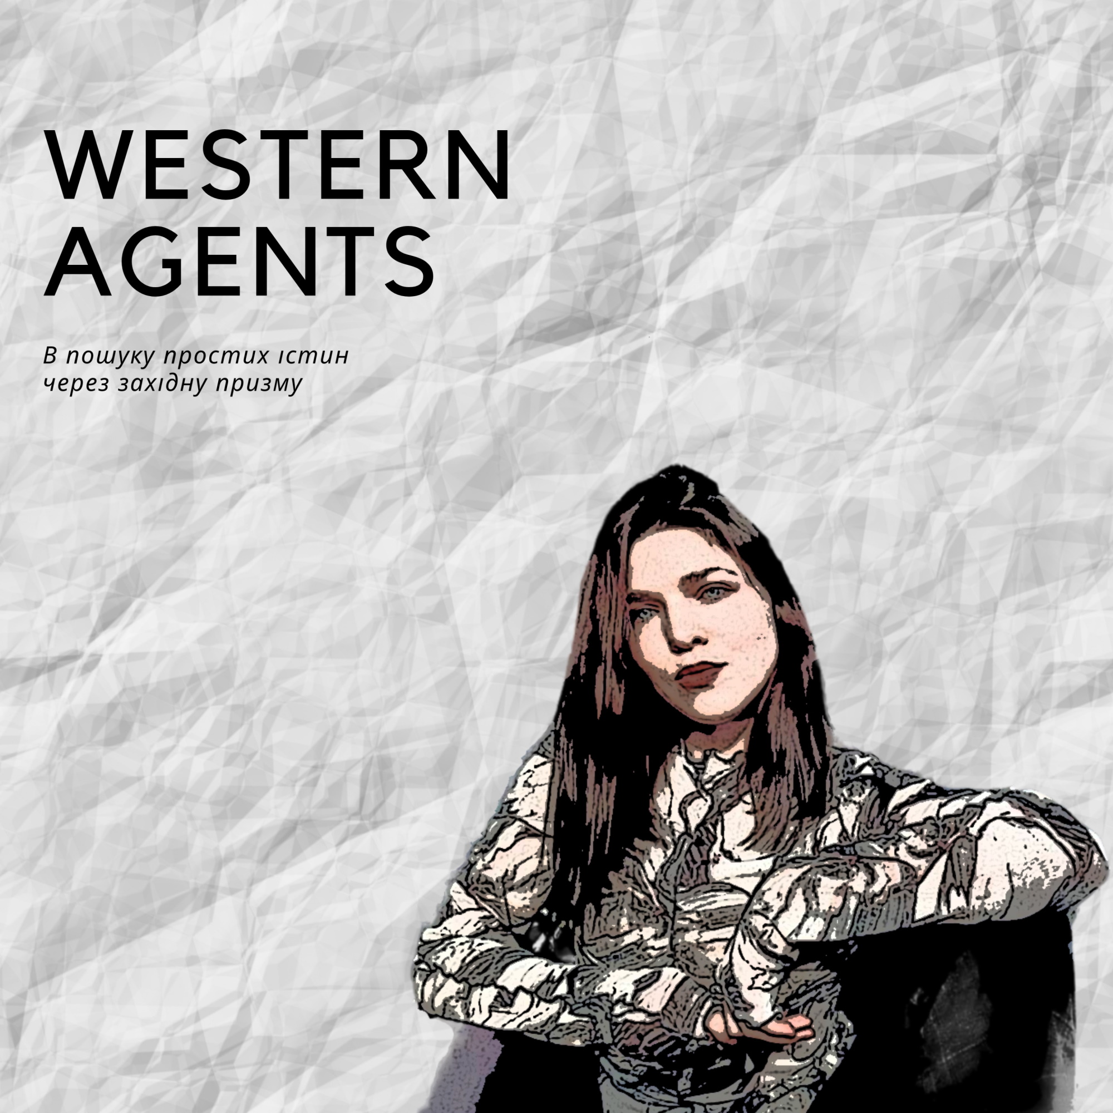
Hobbies

Slide 12

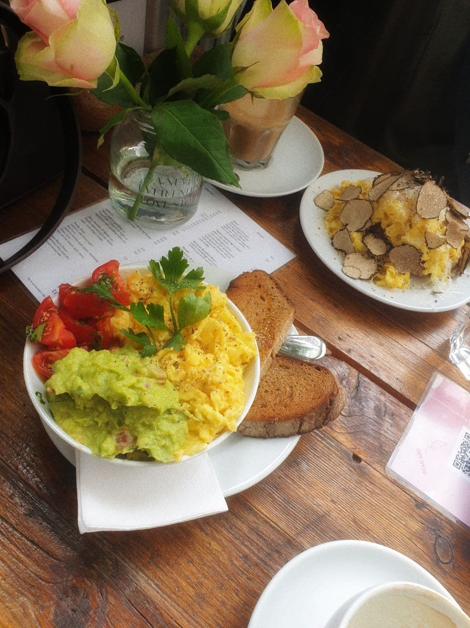
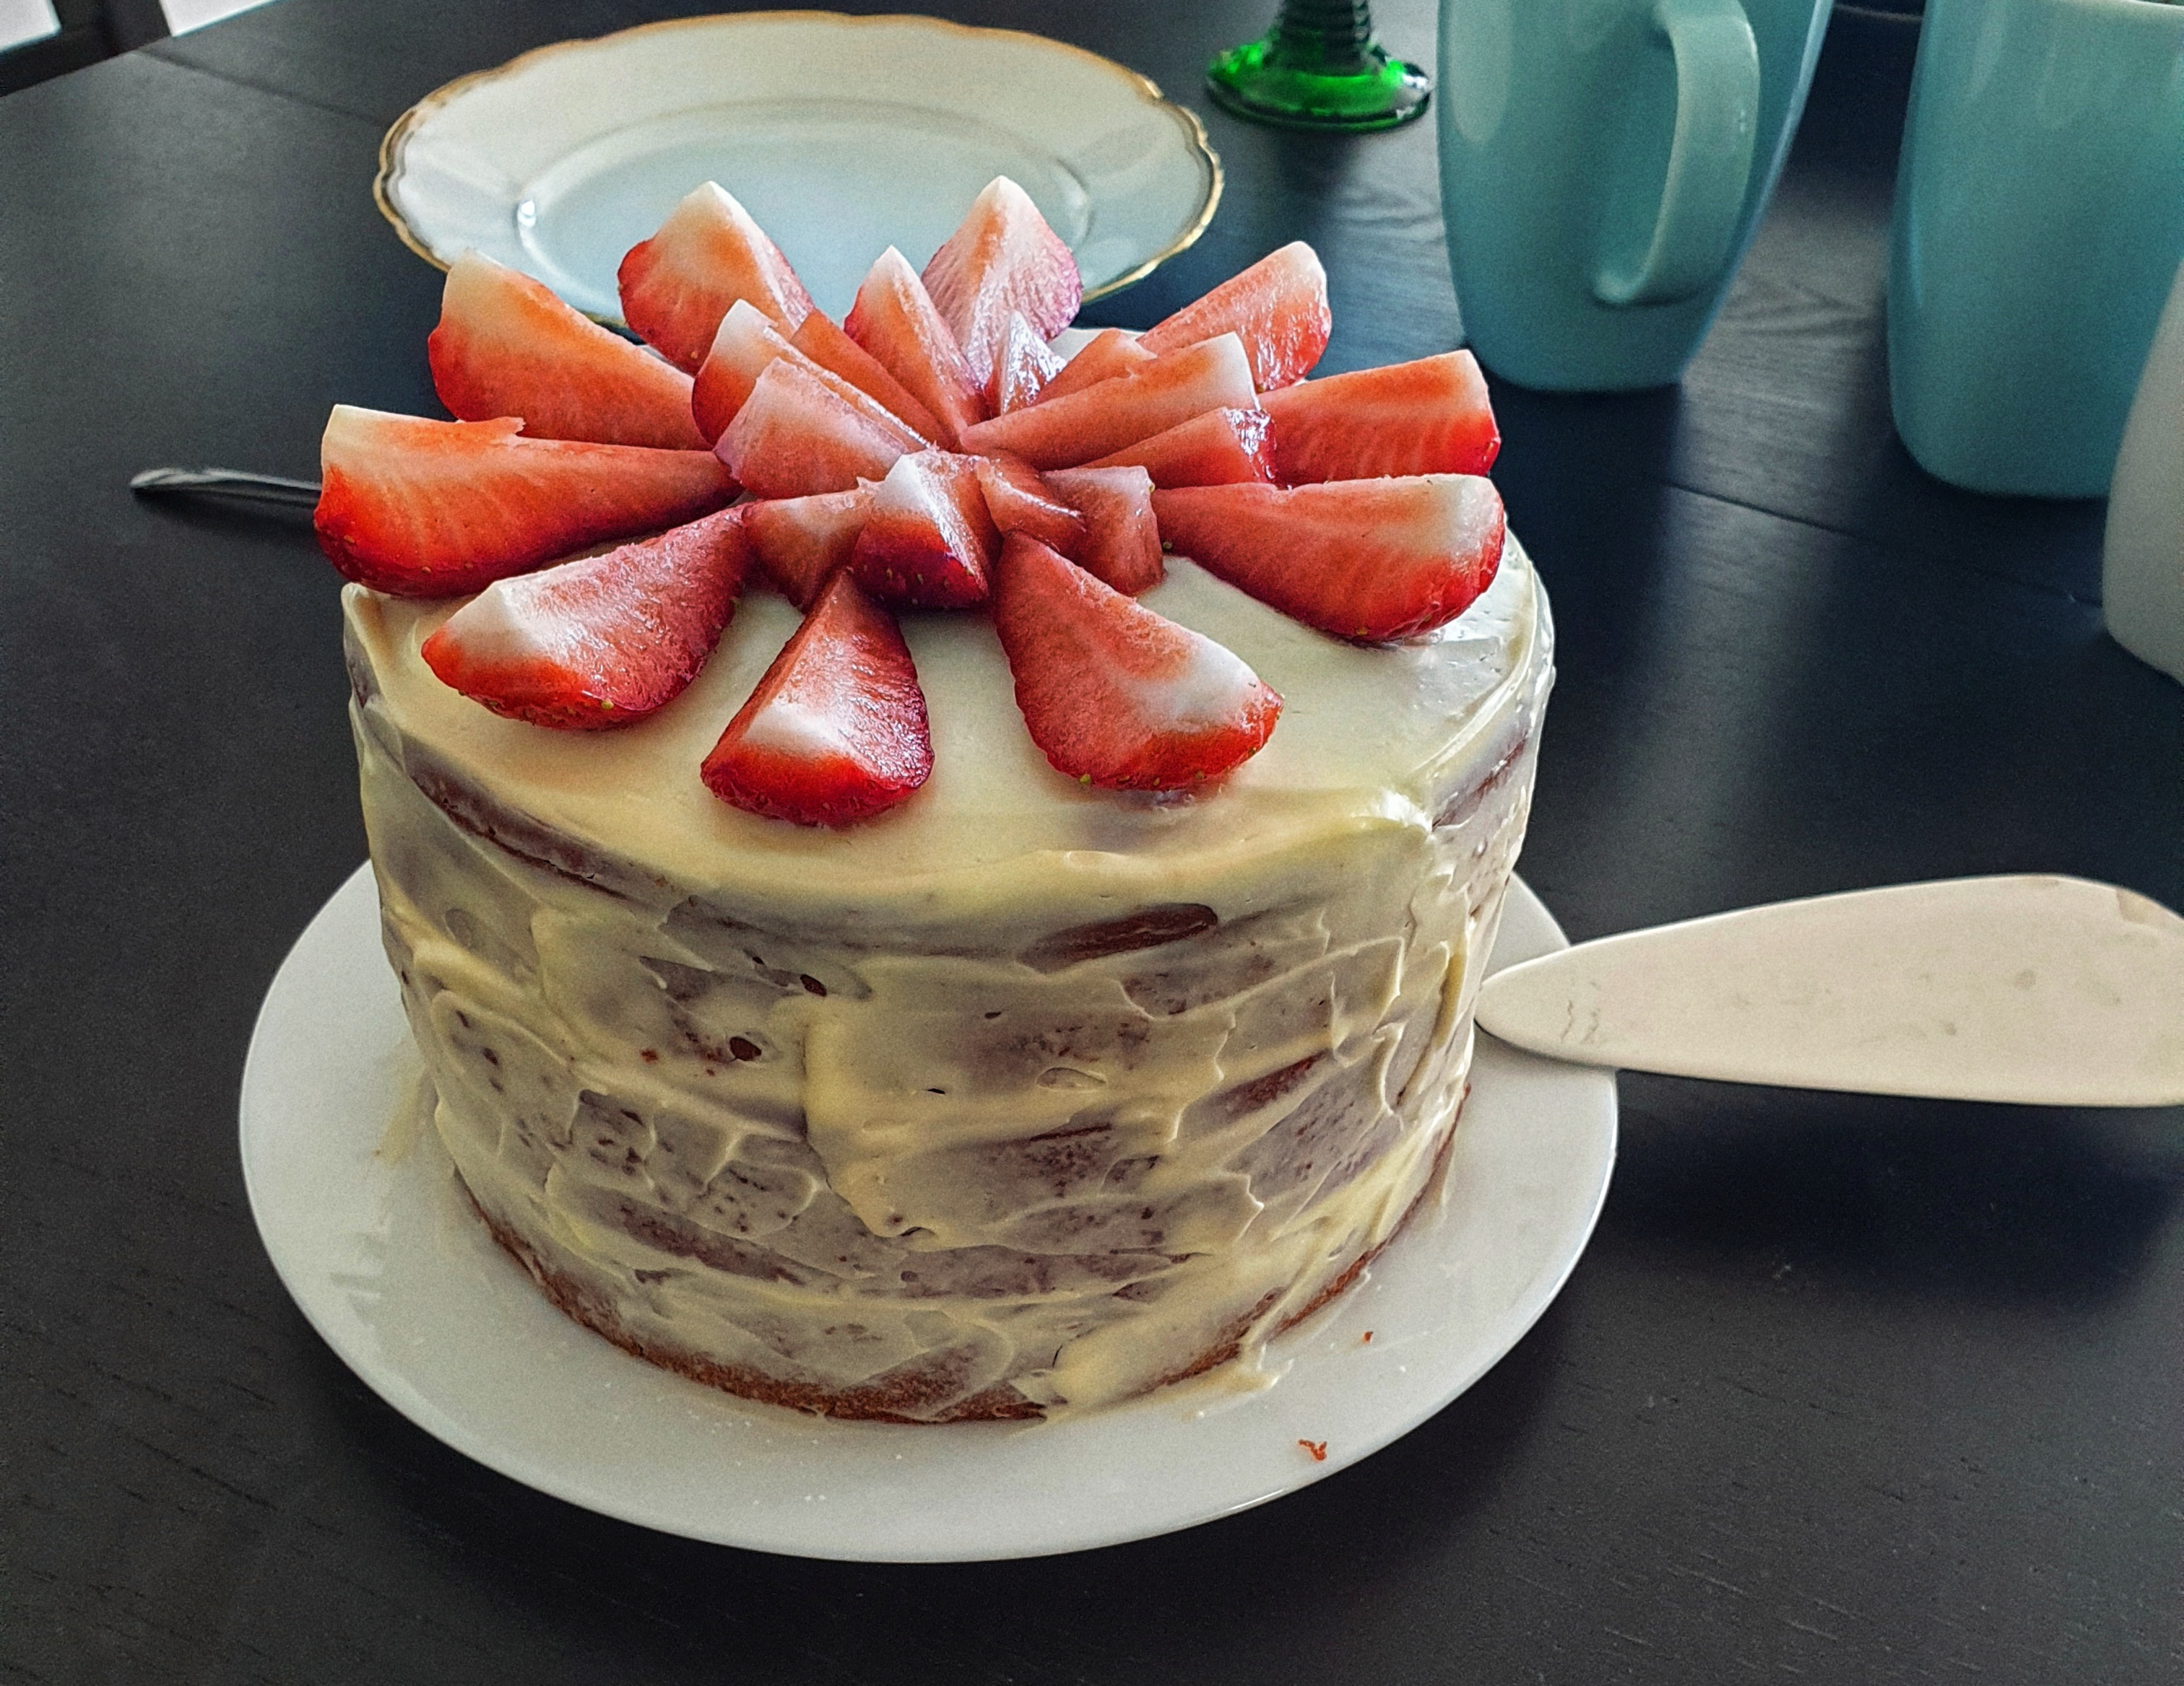
Munchies

Slide 13
Thank you for your attention!
https://www.linkedin.com/in/kseniia-teslenko-ml/
https://github.com/code-ksu
teslenkk@hu-berlin.de

